Slide 1

Credit Score Predict
Home Credit Indonesia Virtual Internship Program
Alia Tungga Dewi
https://github.com/Aliatungga/VIX-Home-Credit-Indonesia

Slide 2
Table of contents
01
02
Problem Research
Data Pre-Processing
03
04
Conclusion
Machine Learning

Slide 3
Problem Research
01

Slide 4
Data
The data is provided by Home Credit, a service dedicated to provided lines of credit (loans) to the unbanked population. Predicting whether or not a client will repay a loan or have difficulty is a critical business need.

Slide 5
The Dataset
application_train /application_test: the main training and testing data with information about each loan application at Home Credit. Every loan has its own row and is identified by the feature SK_ID_CURR. The training application data comes with the TARGET indicating 0: the loan was repaid or 1: the loan was not repaid.
bureau: data concerning client's previous credits from other financial institutions. Each previous credit has its own row in bureau, but one loan in the application data can have multiple previous credits.
bureau_balance: monthly data about the previous credits in bureau. Each row is one month of a previous credit, and a single previous credit can have multiple rows, one for each month of the credit length.
previous_application: previous applications for loans at Home Credit of clients who have loans in the application data. Each current loan in the application data can have multiple previous loans. Each previous application has one row and is identified by the feature SK_ID_PREV.

Slide 6
The Dataset
POS_CASH_BALANCE: monthly data about previous point of sale or cash loans clients have had with Home Credit. Each row is one month of a previous point of sale or cash loan, and a single previous loan can have many rows.
credit_card_balance: monthly data about previous credit cards clients have had with Home Credit. Each row is one month of a credit card balance, and a single credit card can have many rows.
installments_payment: payment history for previous loans at Home Credit. There is one row for every made payment and one row for every missed payment.

Slide 7
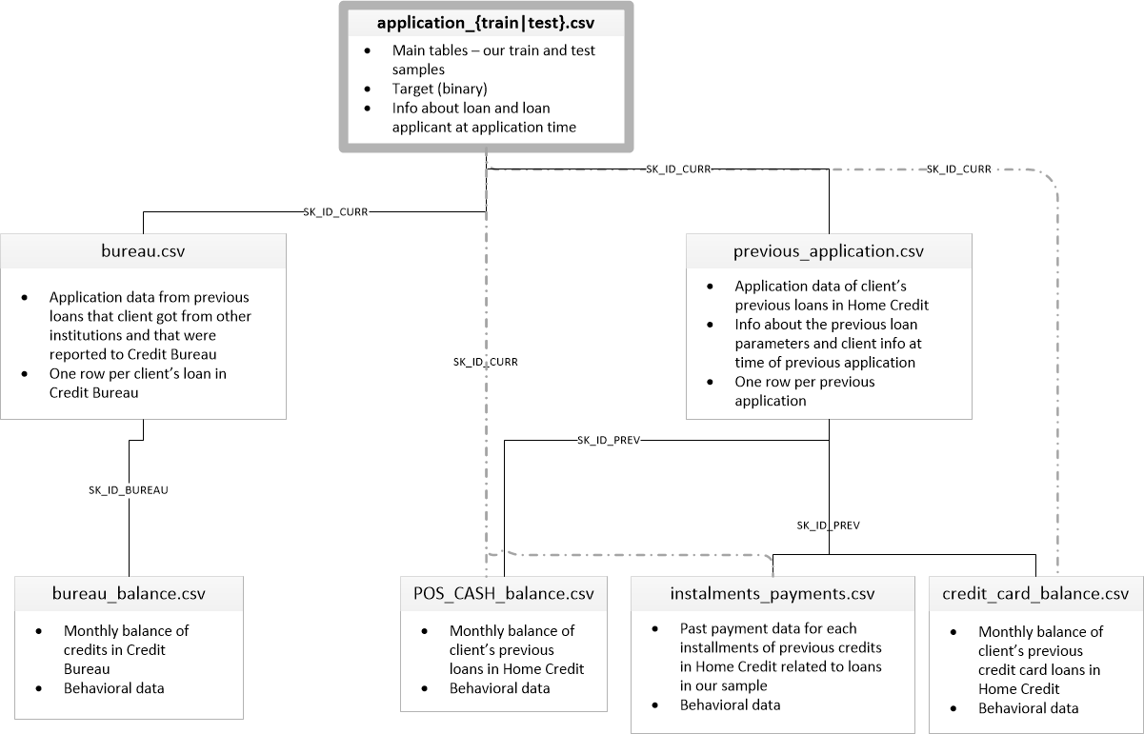
This diagram shows

Slide 8
02
Data Pre - Processing

Slide 9
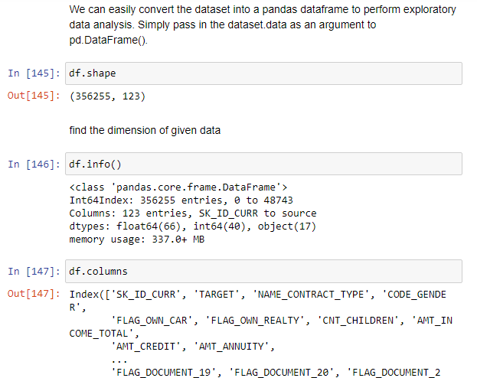
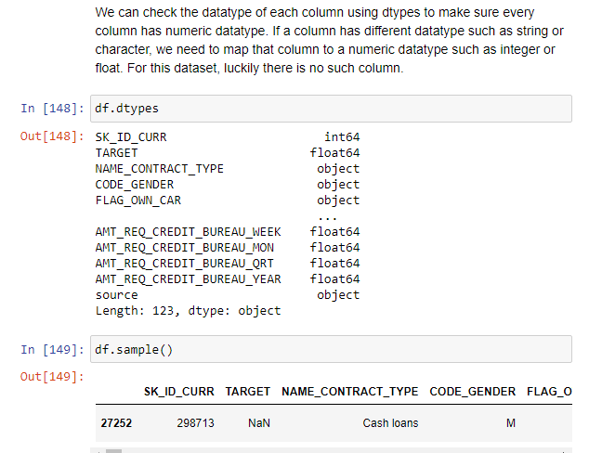
Exploring Data

Slide 10
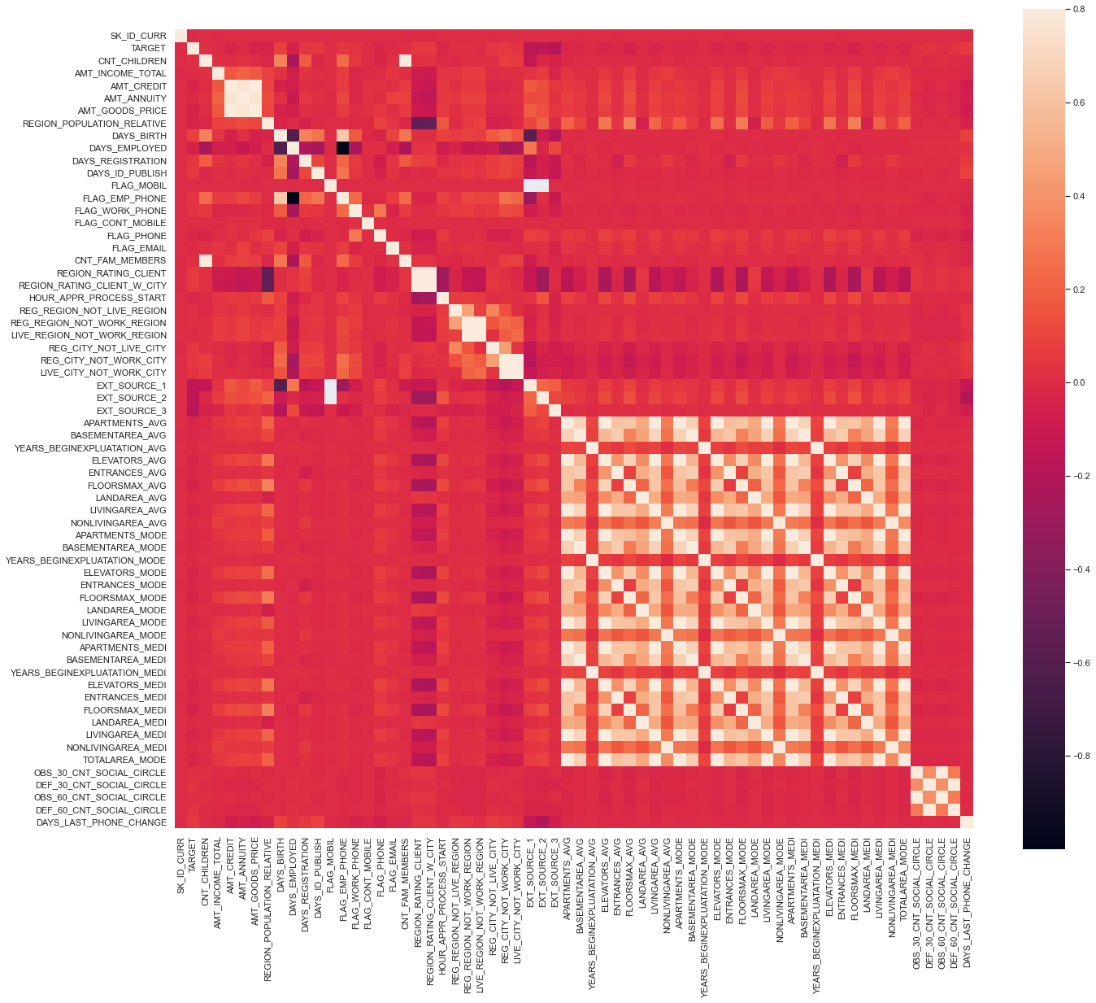
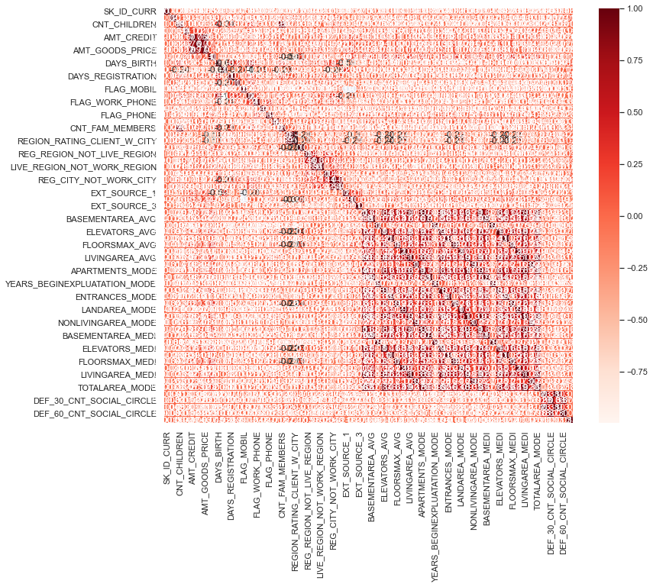
Exploratory Data Analysis (Correlation)
Finding correlation between attributes is a highly useful way to check for patterns in the dataset.
if there are pairs of features that have a high correlation, only one will be taken. The correlation value that is used as a benchmark as a high correlation is uncertain, generally the number 0.7 is used.

Slide 11
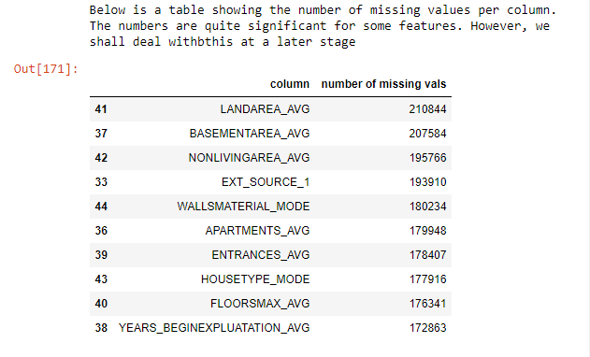
Exploratory Data Analysis (Missing Values)

Slide 12
Machine Learning
03

Slide 13
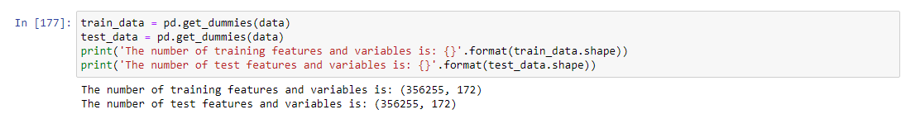
One Hot Encoding
One-hot encoding: create a new column for each unique category in a categorical variable. Each observation recieves a 1 in the column for its corresponding category and a 0 in all other new columns.

Slide 14
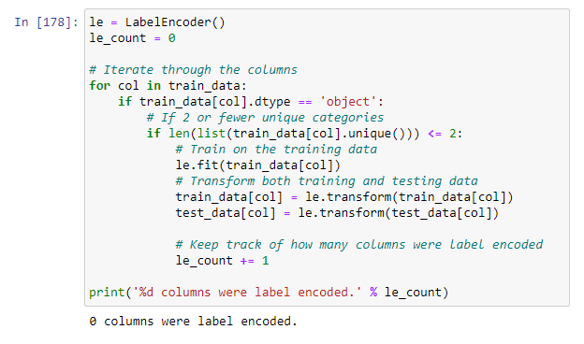
Label Encoding

Slide 15
Conclusion
04

Slide 16
Conclusion
We first made sure to understand the data, our task, and the metric by which our submissions will be judged. Then, we performed a fairly simple EDA to try and identify relationships, or trends that may help our modeling. Along the way, we performed necessary preprocessing steps such as encoding categorical variables, imputing missing values, and scaling features to a range. Then, we constructed new features out of the existing data to see if doing so could help our model.

